Slide 1
AS91883(1.7) & AS91884(1.8) Documentation
Isaac Shin

Slide 2
The Lucky Unicorn
Link to GitHub Repository: GitHub - ShinR4M3N/The-Lucky-Unicorn
Links to Trello board / project management tools: [here]
Link to final version of your program: [here]
Ensure you have made these links ‘public’ so that they are open to anyone, including the marker. The link to your program is the final outcome of this whole project – your finished program.

Slide 3
Describe relevant Implications 1:
Additional rows can be added by clicking in the last cell and then using the Tab key
Relevant implication | Describe the implication and give an example
Functionality | Functionality is when the programming is working as it should be. It should work for expected, boundary and unexpected cases. For example, If my programs ask for your age, It should work for expected input like ‘15’ but it should not crash when the user enters something invalid like letters.
Usability | Usability is about how easily an user can use the program and do what is suppose to do. It should deal with issues like making instructions and error messages that are easy for the user to understand. It is important that we do not include things in our program that could confuse the users.
Aesthetics | Aesthetics is about the overall appearance of the program. An aesthetic program should include spaced instruction, prompts and decorations. Aesthetics makes the program better for our eyes, but when we include aesthetics into our program, it may be easier for the user to use compared to a program that does not have any aesthetical features. Example: With Aesthetical features -Question: <input> Without - Question<input>
Notes:
Additional rows can be added by clicking in the last cell and then using the Tab key

Slide 4
Describe relevant Implications 2:
Additional rows can be added by clicking in the last cell and then using the Tab key
Relevant implication | Describe the implication and give an example
Social | The Social implication of a computer program are about the affect it may cause to the society. For example games that can help you learn and teach can receive positive feedback unlike games that can get you addicted.
Future proofing | Future proofing is about making your code that can be easily modified and developed. It must be well set out and easy to read so other people can change your program to make it better in the future. People that are modifying your program must know the purpose and the reason behind the program
Notes:
Additional rows can be added by clicking in the last cell and then using the Tab key

Slide 5
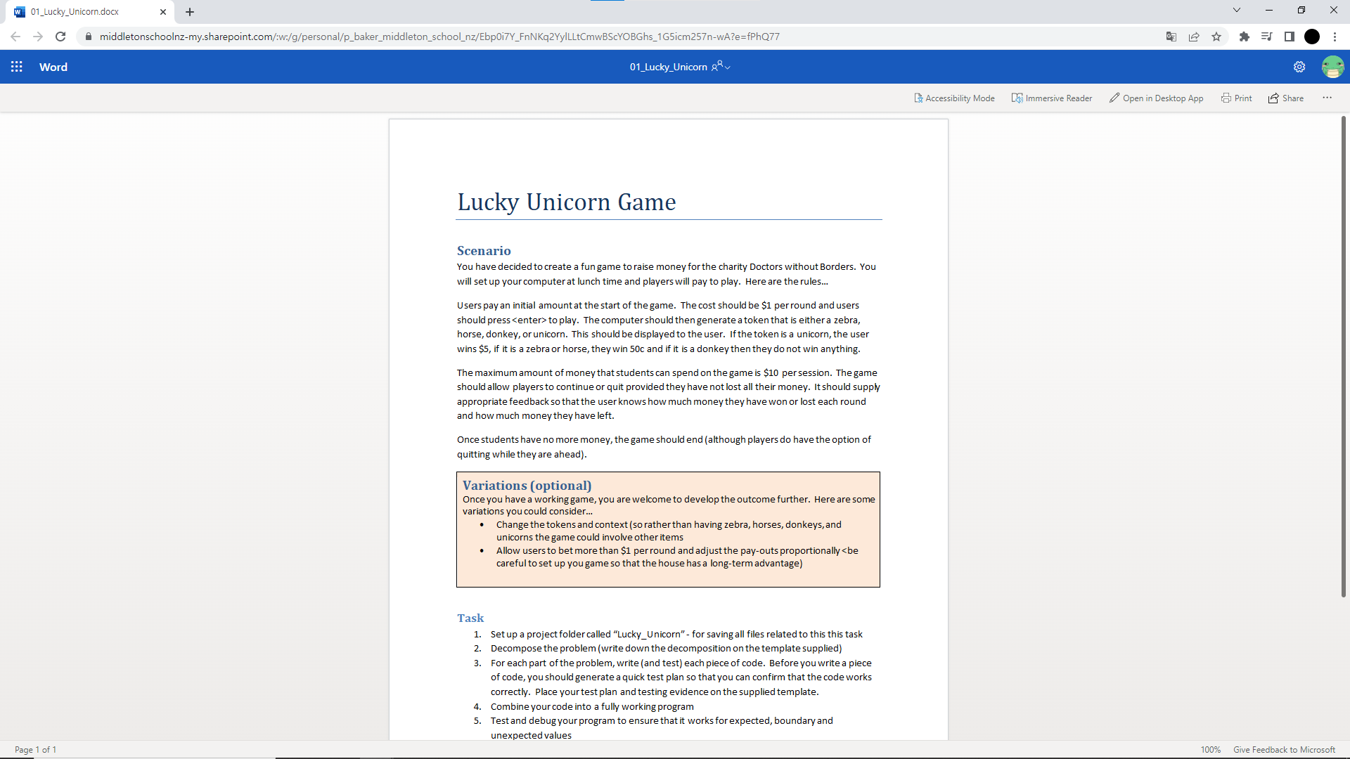
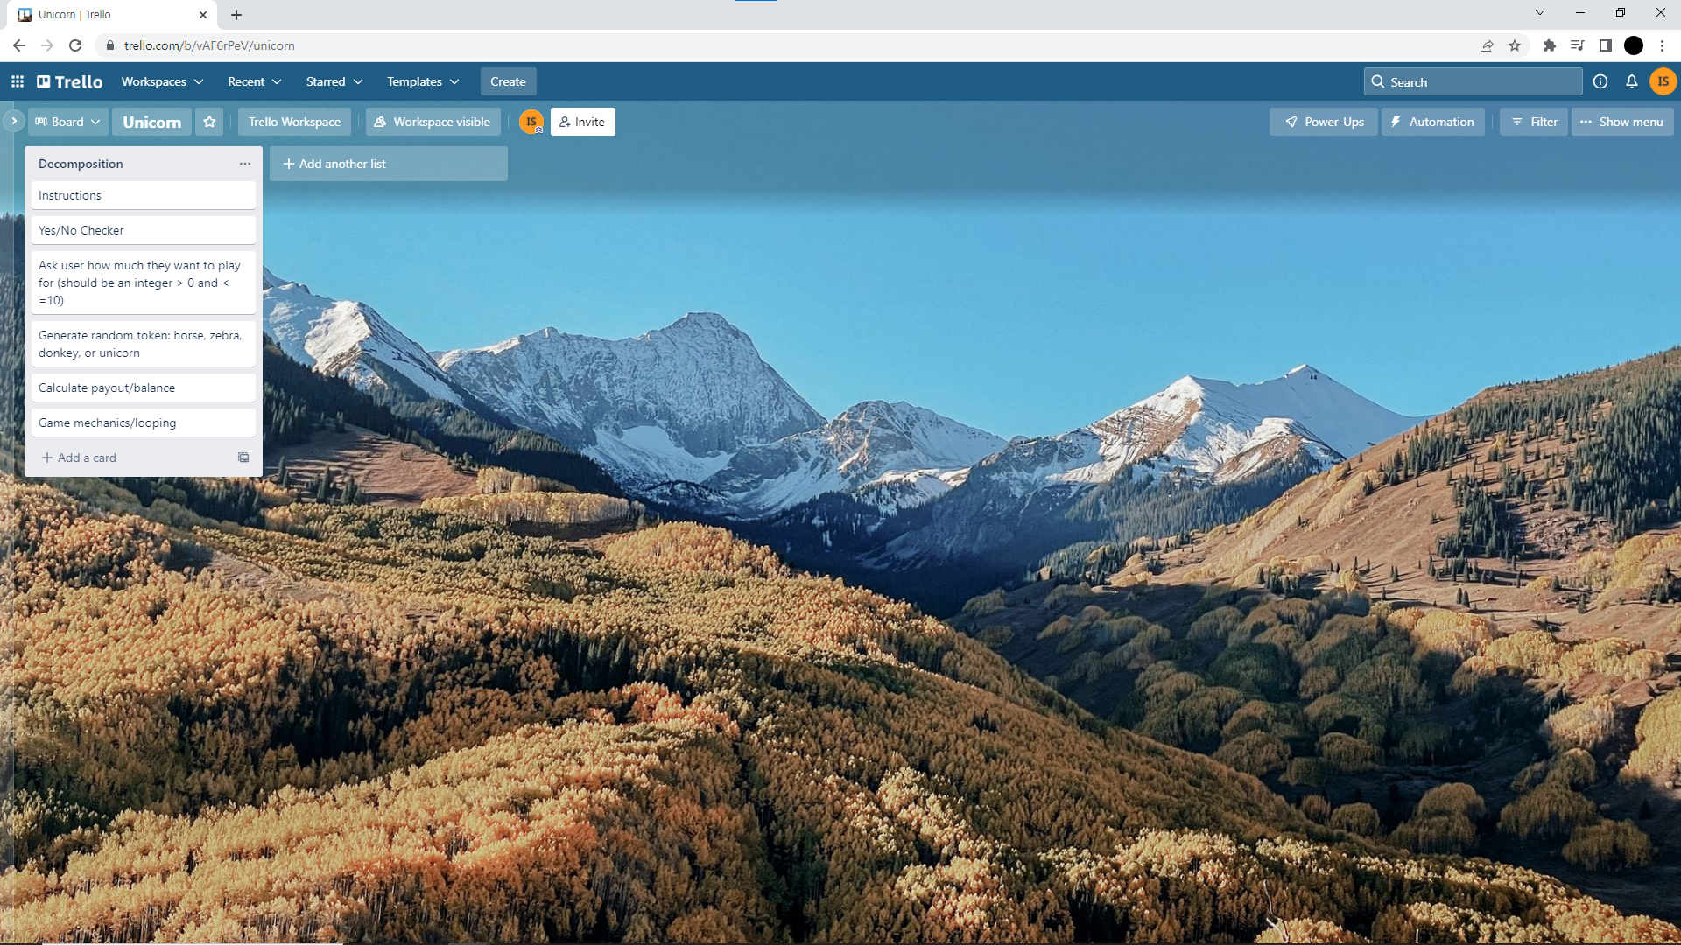
Decomposition:
Paste screenshots of your initial Trello board / task decomposition on this slide. If you have a long list, you might need to break it up into several slides.
Notes:
Paste screenshots of your initial Trello board / task decomposition on this slide. If you have a long list, you might need to break it up into several slides.

Slide 6
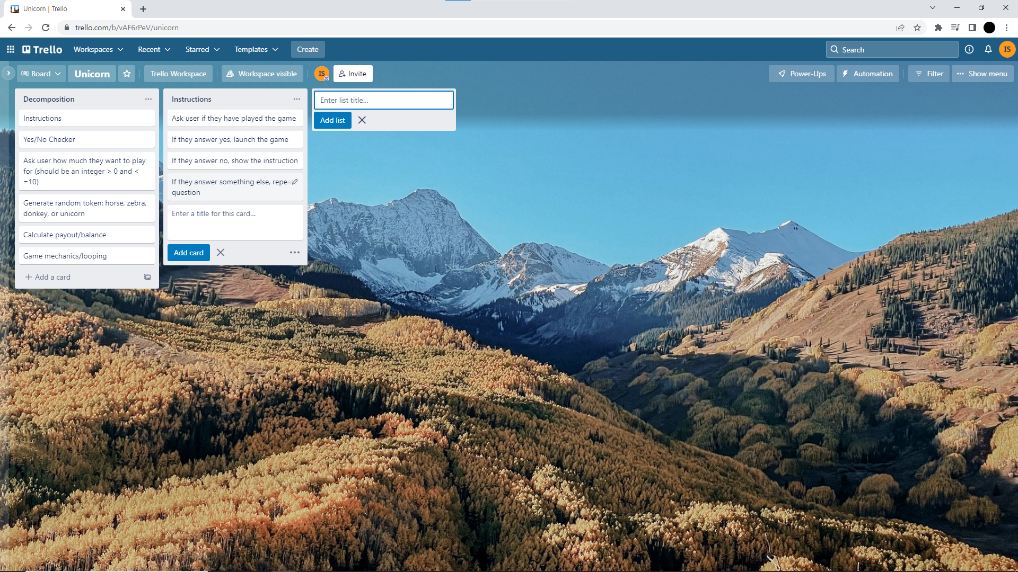
Component 1 (Instruction and Yes/No checker

Slide 7
Yes/No checker- Test Plan
Additional rows can be added by clicking in the last cell and then using the Tab key
Test Cases - input | Expected output
Yes or Y | Program continues
No or N | Program continues
Other | Please enter either “Yes” or “No”
Notes:
Additional rows can be added by clicking in the last cell and then using the Tab key

Slide 8
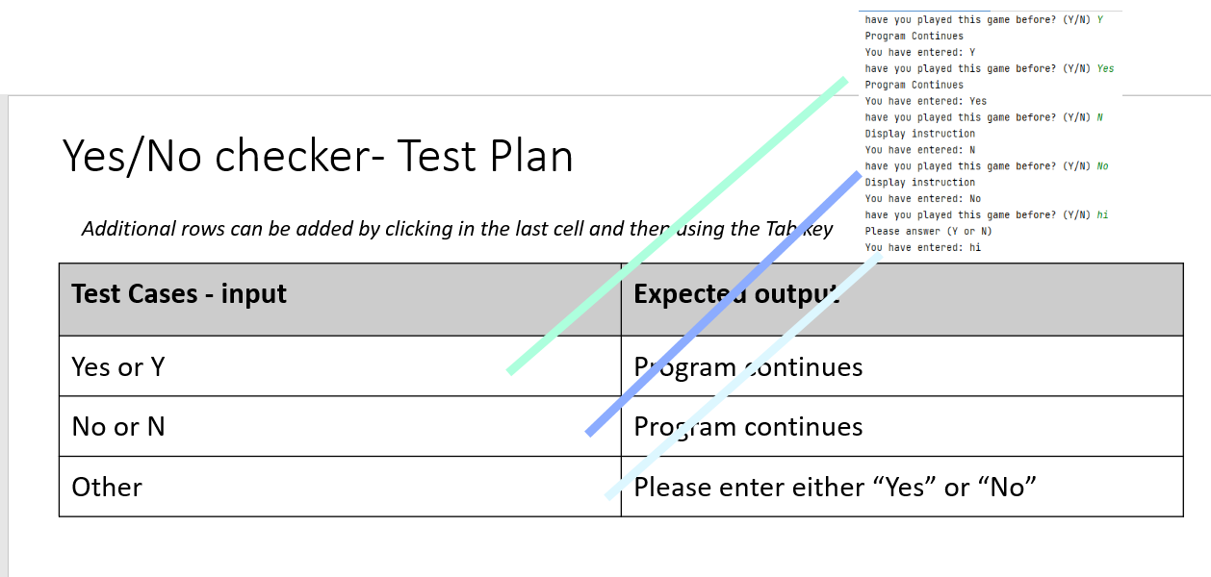
Yes/No checker- Test Plan
All test work as it should be

Slide 9
Yes/No checker: Trialling
Trial 1 01 | Program would start but only accept “Y” or “N” as an answer. It would not accept other answers such as “Yes”
Trial 2 01 yes or no v2 | Adding more possible answers and printing your answers at the end of the code.
Trial 3 01 yes or no with while v3 | Using while loop to loop the program
Trial 4 V4 with def | Added function to the code, making it easier to run the program in the future
Notes:
NOTE: Trialling needs to happen for at least 2 of your components but is not necessary for ALL components.
Trialling is not the same as testing. Trialling is about finding different ways of building the same component. Show evidence of your trialling here. Select one of your trials for further development and give reasons for your choice.

Slide 10
[Component name]: Trialling
NOTE: Trialling needs to happen for at least 2 of your components but is not necessary for ALL components.
Trialling is not the same as testing. Trialling is about finding different ways of building the same component. Show evidence of your trialling here. Select one of your trials for further development and give reasons for your choice.
Notes:
NOTE: Trialling needs to happen for at least 2 of your components but is not necessary for ALL components.
Trialling is not the same as testing. Trialling is about finding different ways of building the same component. Show evidence of your trialling here. Select one of your trials for further development and give reasons for your choice.

Slide 11
Instruction - Test Plan
Additional rows can be added by clicking in the last cell and then using the Tab key
Test Cases - input | Expected output
Have you played this game before? Maybe, not sure, other | <error> Please choose Y/N
Have you played this game before? Yes | Game Starts
Have you played this game before? No | Show instruction Start game
Notes:
Additional rows can be added by clicking in the last cell and then using the Tab key

Slide 12
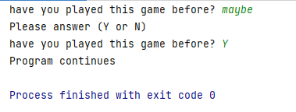
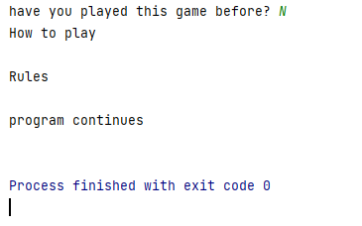
Instruction (with Y/N checker): Testing
You must show the results of testing. For each component, include a screenshot proving it works. You can also include notes about each test.
Test Cases - input | Expected output
Have you played this game before? Maybe, not sure, other | <error> Please choose Y/N
Have you played this game before? Yes | Game Starts
Have you played this game before? No | Show instruction Start game
Notes:
You must show the results of testing. For each component, include a screenshot proving it works. You can also include notes about each test.

Slide 13
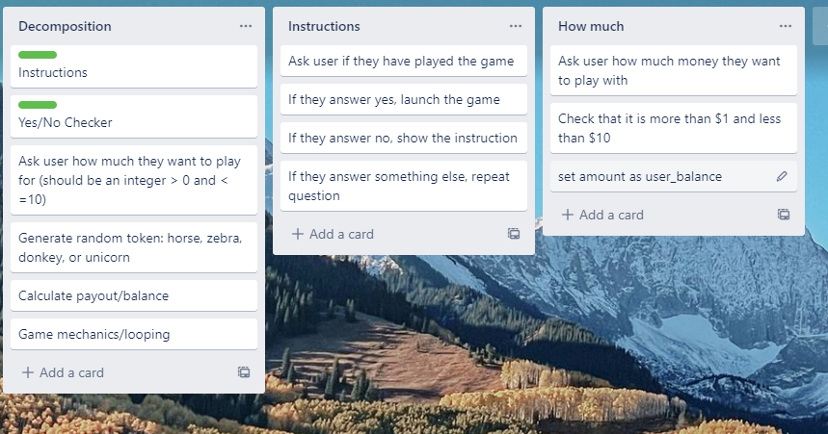
Component 2(How Much)

Slide 14
How Much: Test plan
Test cases – input | Extended output
xxii (invalid – string) | <error> Please enter a whole number between 1-10
0.5 (invalid - float) | <error> Please enter a whole number between 1-10
0 (invalid - too low) | <error> Please enter a whole number between 1-10
11 (invalid – too high) | <error> Please enter a whole number between 1-10
1 (valid – lower boundary) | Program continues
10 (valid – upper boundary) | Program continues

Slide 15
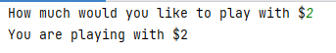
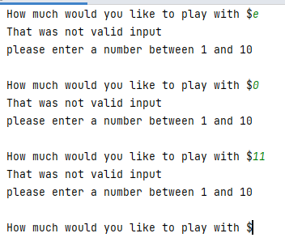
How much: Testing

Slide 16
Yes/No checker: Trialling
Trial 1 How much v1 | Program only function when you enter a whole number between 1-10. Otherwise, it would crash.
Trial 2 How much v2 | The program would not crash this time when you enter something invalid and will get another chance to try again
Trial 3 How much v3 | Made trial 2 shorter and included valid range.
Trial 4 How much v4 | Changed v3 to function making it more easier to develop and use.
Notes:
NOTE: Trialling needs to happen for at least 2 of your components but is not necessary for ALL components.
Trialling is not the same as testing. Trialling is about finding different ways of building the same component. Show evidence of your trialling here. Select one of your trials for further development and give reasons for your choice.

Slide 17
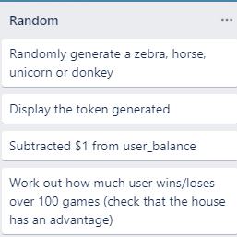
Component 3 (Generate random token)
The pay out schedule is:
Donkey lose $1
Horse/Zebra lose $0.50
Unicorn win $4
(If user starts with $1 and gets a unicorn, their balance would be $5)

Slide 18
Test Plan: house has the advantage
Test cases – input | Extended output
User starts with $100 Runs program | User should lose money (final balance should be less than $100)

Slide 19
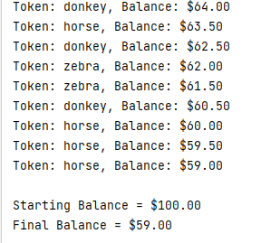
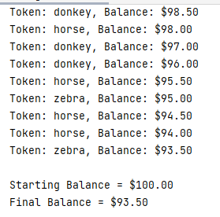
Generate random token – Testing
Testing on the right shows
The result of 100 rounds
Testing on the right shows
The result of 10 rounds

Slide 20
Generate random tokens: Trialing
Trial 1 Token generator v2 | This program chooses from a list of ‘horse, ‘unicorn’, ‘donkey and ‘zebra’. When run 100 times, it became clear that the house would lose money instead of making it.
Trial 2 Token generator v3 | In this trial I changed the list so that there were 10% unicorns and 30% of each of the others (1 unicorn and 3 of each other cards). This did give the house an advantage.
Trial 3 Token generator v4 | In my third trial, instead of choosing items from a list, I chose a random integer between 1 and 100. The schedule was set upt so that users had a 5% chance of getting a unicorn, a 30% chance of getting a donkey and a 65% change of getting a horse or a zebra. For this last 65% it awarded horse or zebra depending whether or not the number generated was even (zebra) or odd (horse).

Slide 21
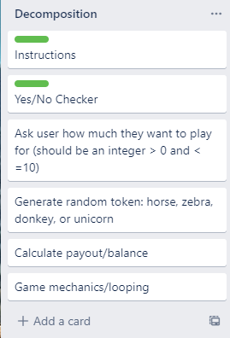
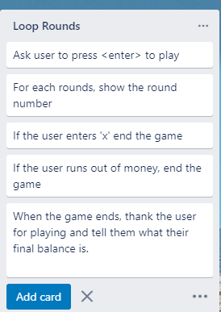
Game mechanics and looping

Slide 22
Test plan: Game mechanics and looping
Test cases – input | Extended output
User starts with $5 User continues playing until the money runs out | Game should go for 5 rounds. Each round should be correctly numbered After 5 rounds, it should display ‘Sorry you have run out money’
Starting amount $5 User plays 3 rounds and then exits | Game should go for 3 rounds When user enters ‘X’ the game should end Final balance should be $2

Slide 23
Assembled Outcome Testing:
Show testing for your assembled outcome below. This should include a test plan followed by screenshot proof.
Notes:
Show testing for your assembled outcome below. This should include a test plan followed by screenshot proof.

Slide 24
Address relevant Implications:
Relevant implication | Explain how your final outcome addresses each implication

Slide 25
Version Control Evidence:
Your version control evidence should go here. This could be in the form of screenshots (both of your GitHub repository as well as your local project folder) as evidence of your incremental development.
Notes:
Your version control evidence should go here. This could be in the form of screenshots (both of your GitHub repository as well as your local project folder) as evidence of your incremental development.

Slide 26
Final Discussion:
Discuss how the information from planning, testing and trialling of components assisted in the development of a high-quality outcome.
Notes:
Discuss how the information from planning, testing and trialling of components assisted in the development of a high-quality outcome.

